Slide 1
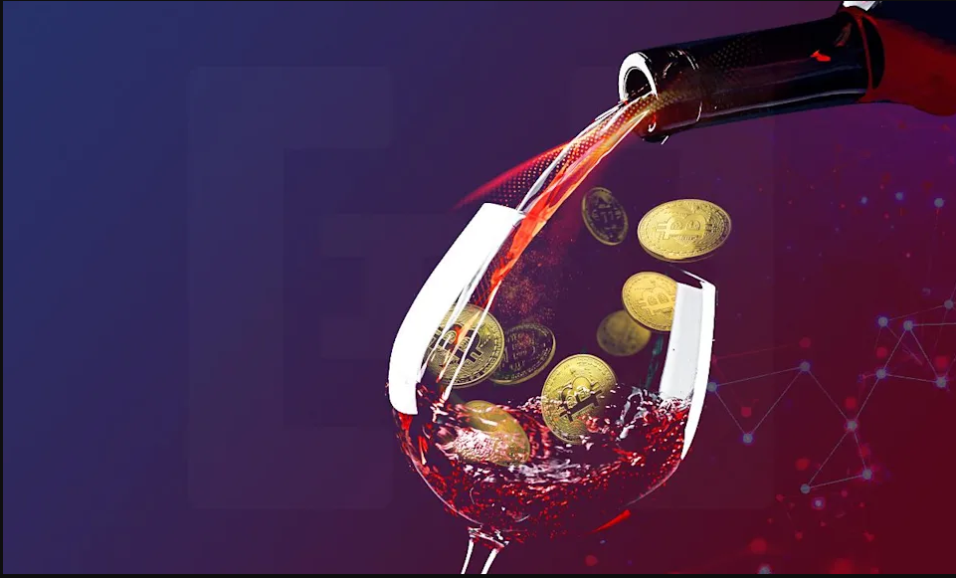
The (Digital) Rare Wine Market
Team Members: Andre Bacellar, Benny Adler, Rina Niles, Michael Bowey, Alice Lin

Slide 2
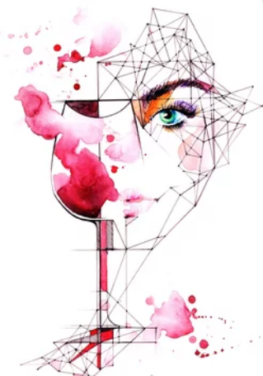
Project Objectives
Test potential use case for buying/selling physical goods digitally via NFT architecture
Learn about The Graph (Infrastructure protocol)
Uniswap
AAVE
Decentraland

Slide 3
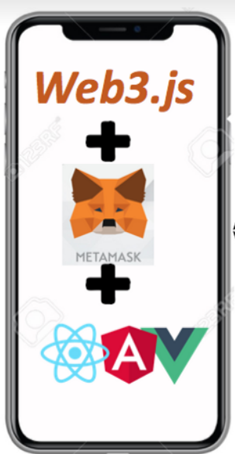
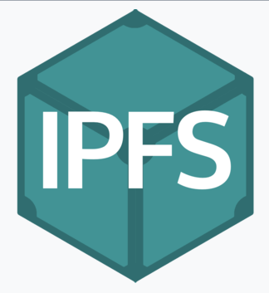
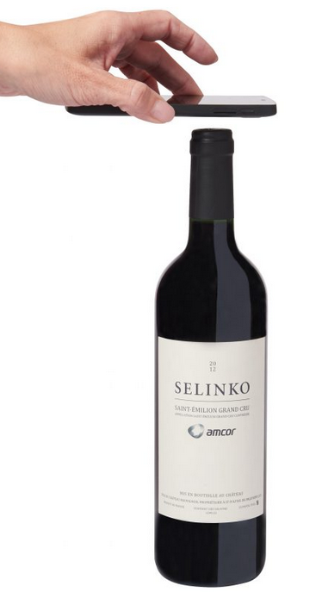
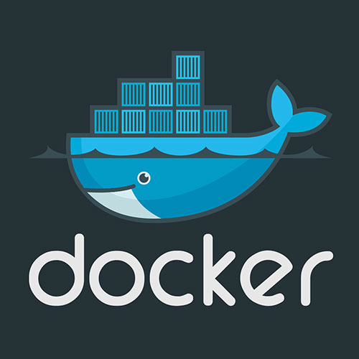
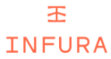
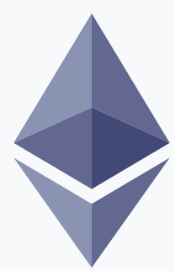
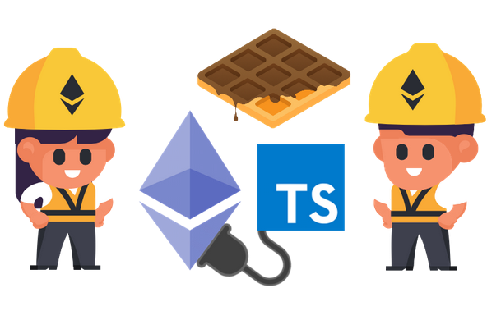
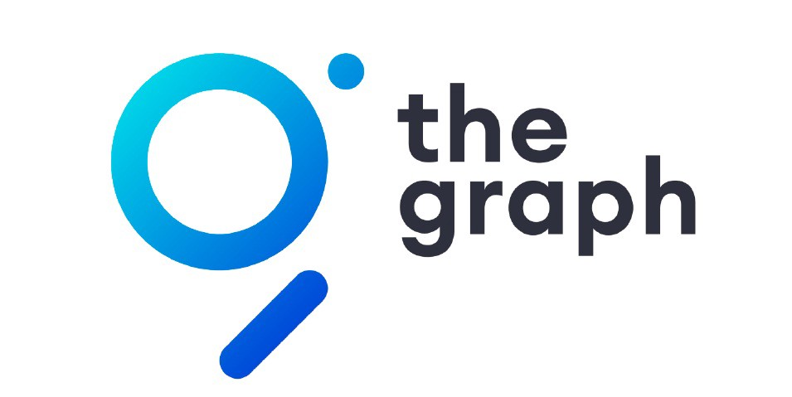
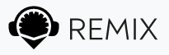
Vino Dapp Architecture
IRL process
Dapp
Middle
Back end
Dev environment
Notes:
Business case
A main factor is determining the value of fine wines is Provenance which refers to the purchase, ownership, and storage history of a wine.
Currently, provenance for fine wines is determined by two main factors: 1) an expert who evaluates signs of authenticity, and 2) the reputation of the person selling wine. Inspecting wine is expensive and time-consuming process; relying on the seller’s reputation is also risky for all the obvious reasons.
As the kids like to say, “Bitcoin fixes this” -- it provides provenance through the minting of NFTs. With smart chip technology the temperature which the wine was subjected to over time as well as any tampering with the cork is also addressed and handled through the contract.
//With the VINO dapp If a winery were to specify in an asset contract that collectors could take physical delivery far into the future, the winery could begin to function like a bank. There could be a vibrant market trading digital wine contracts, backed by wine reserves which are held securely by the winery and rarely redeemed until the wine is ready for consumption.
Architecture

Slide 4
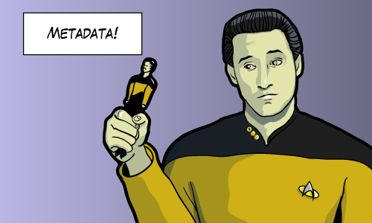
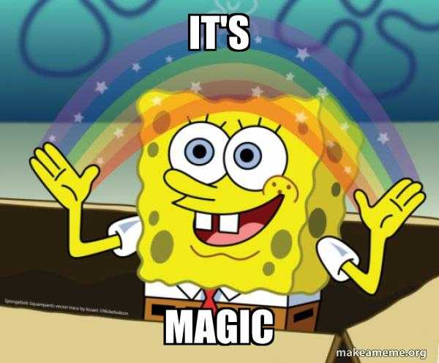
Query a decentralized database?
Notes:
How are we gonna be mimic Google Search in the decentralized world? The answer is MAGIC!

Slide 5
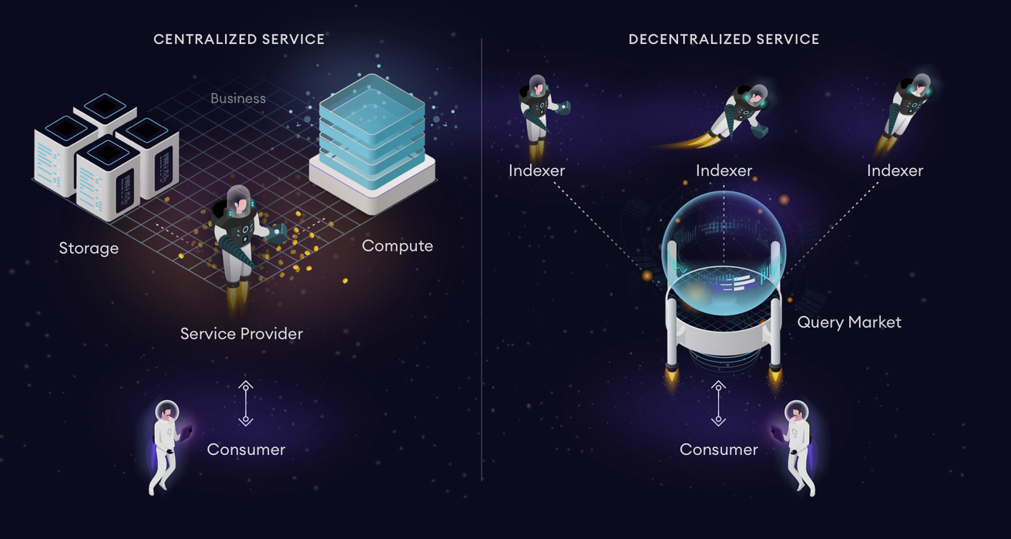
Notes:
The two images pretty much capture the essence of GraphQL. With the query on the right we can define exactly what data we want, so there we get everything in one request and nothing more than exactly what we need. A GraphQL server handles the fetching of all data required, so it is incredibly easy for the frontend consumer side to use

Slide 6
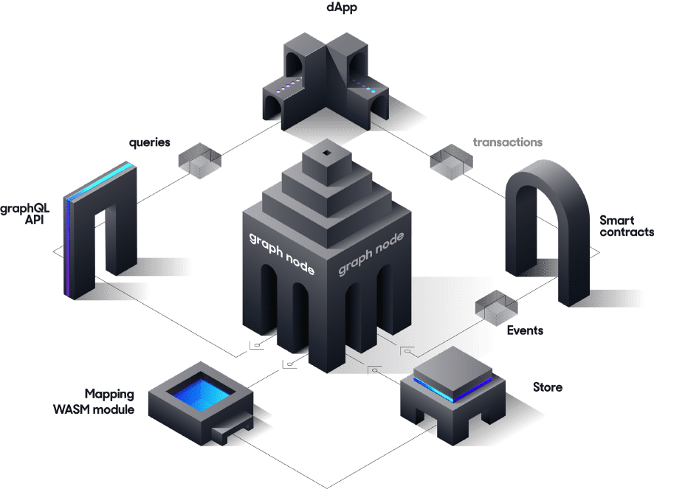
Query using The Graph
Start here
4
2
5
3
Notes:
What The Graph Is#
The Graph is a decentralized protocol for indexing and querying data from blockchains, starting with Ethereum. It makes it possible to query data that is difficult to query directly.
Even for this relatively simple question such as who are the owners of the token123 between year x and year y, it would take hours, or even days, for a decentralized application (dApp) running in a browser to get an answer. Indexing blockchain data is hard. Blockchain properties like finality, chain reorganizations, or uncled blocks complicate this process further, and make it not just time consuming but conceptually hard to retrieve correct query results from blockchain data.
The Graph solves this today with a hosted service that indexes blockchain data. These indexes ("subgraphs") can then be queried with a standard GraphQL (Query Language) API. In the future, the hosted service will evolve into a fully decentralized protocol with the same capabilities. Both are backed by the open source implementation of Graph Node.
How The Graph Works#
The Graph learns what and how to index Ethereum data based on subgraph descriptions, known as the subgraph manifest. The subgraph description defines the smart contracts of interest for a subgraph, the events in those contracts to pay attention to, and how to map event data to data that The Graph will store in its database.
Once you have written a subgraph manifest, you use the Graph CLI to store the definition in IPFS and tell the hosted service to start indexing data for that subgraph.
This diagram gives more detail about the flow of data once a subgraph manifest has been deployed, dealing with Ethereum transactions:
The flow follows these steps:
A decentralized application adds data to Ethereum through a transaction on a smart contract.
The smart contract emits one or more events while processing the transaction.
Graph Node continually scans Ethereum for new blocks and the data for your subgraph they may contain.
Graph Node finds Ethereum events for your subgraph in these blocks and runs the mapping handlers you provided. The mapping is a WASM module that creates or updates the data entities that Graph Node stores in response to Ethereum events.
The decentralized application queries the Graph Node for data indexed from the blockchain, using the node's GraphQL endpoint. The Graph Node in turn translates the GraphQL queries into queries for its underlying data store in order to fetch this data, making use of the store's indexing capabilities. The decentralized application displays this data in a rich UI for end-users, which they use to issue new transactions on Ethereum. The cycle repeats.
Demo
https://thegraph.com/studio/subgraph/winenfts/
Test query
{
erc721Tokens {
id
identifier
uri
}
}
{
erc721Tokens(
orderBy: identifier,
orderDirection: asc
) {
id
identifier
uri
}
}
{
erc721Transfers(
orderBy: timestamp
orderDirection: desc
) {
timestamp
token {
identifier
uri
}
}
}
{
accounts {
id
ERC721tokens {
identifier
uri
}
}
}

Slide 7
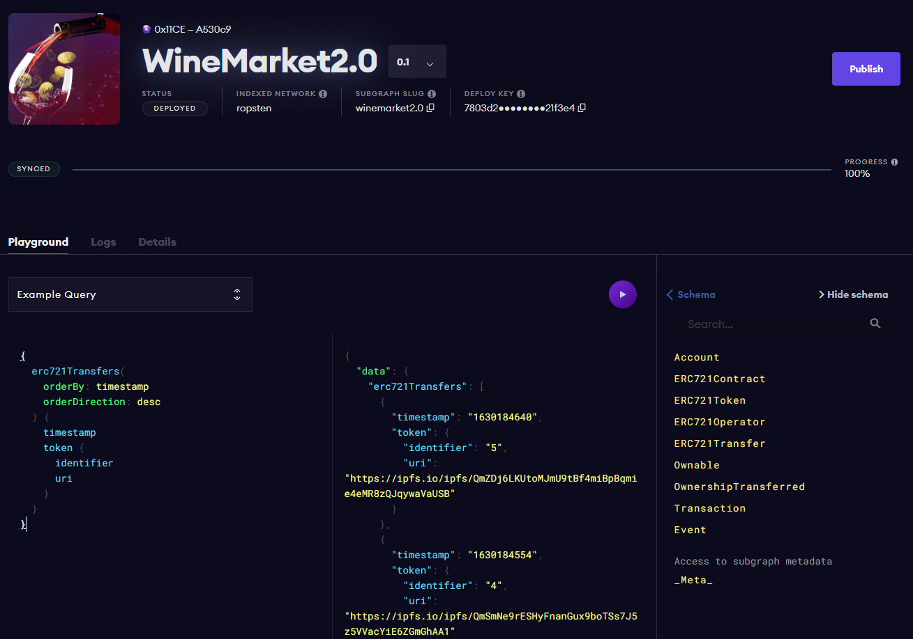
Graph Playground

Slide 8
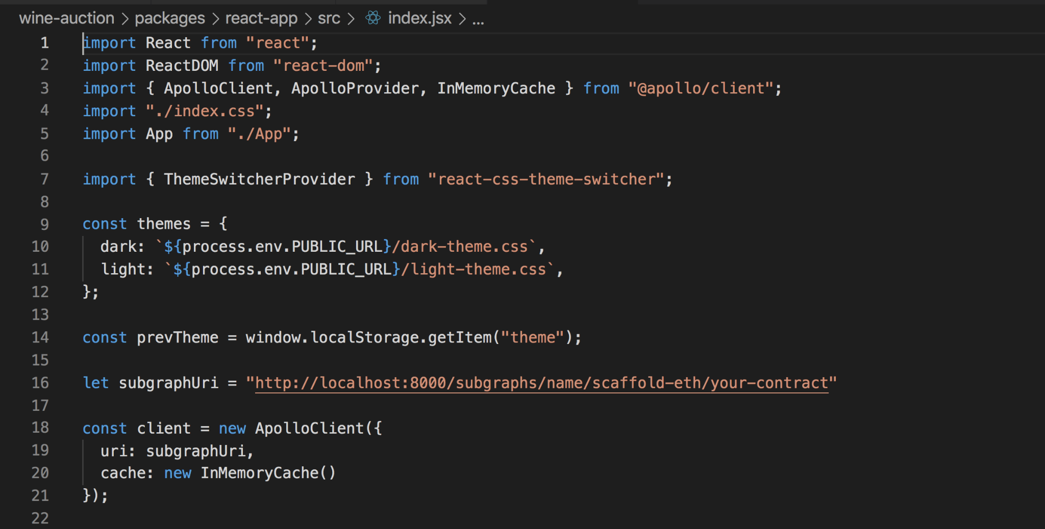
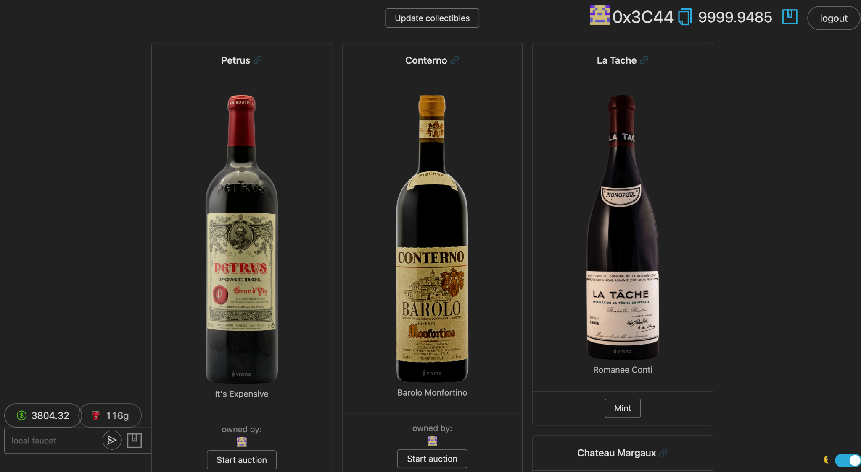
Building Front End via Graph

Slide 9
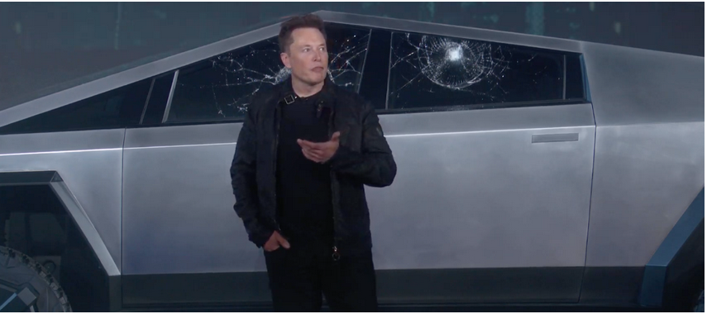
Demo

Slide 10
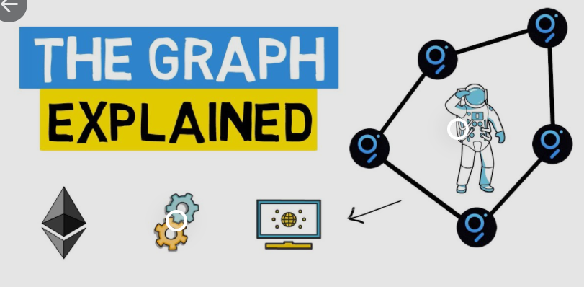
GRT - Graph Tokenomics
The Graph (GRT) coin is the native token of the network. Its main use is coordinating the work on The Graph. GRT is an ERC20 token. Node operators, called Indexers, stake and earn GRT for processing queries. Anyone can delegate GRT to Indexers to secure the network and earn rewards

Slide 11
Next Steps
Centralized warehouse for bottle storage and maintenance
VINO holders can show off their collection virtually via online gallery
Holders can buy or sell their bottles without actually having to move the physical
If a holder decides they want to drink their bottle, they can burn their token in exchange for the physical bottle and receive an “Open bottle” NFT
Open bottle tokens can be used to show off bottles the holder has previously owned but cannot be exchanged for a physical.
VINO makes money as a business by taking a small percentage of every transaction🤑🤑🤑
Notes:
Collectible wine is a multi-billion dollar industry and the use of NFTs to provide provenance (aka title) would greatly wine fraud and increase the size/accessibilty of the secondary market thereby increase the value of fine wine as an asset class.

Slide 12
